Slide 1

VyOS: Network Operating System
Introduction and Quick Start Workshop

Slide 2
Mehdi Sarmadi
Professional Life
Open Source Consultant/Enthusiast
14 years of Linux/OpenSource Journey
Data Center Service Consultant/Project Manager
Identity and Access Management Architect
HPC Architect
Performance Engineering
Product Design
CTO of Aris System
https://github.com/msarmadi/vyos-workshop-2015
msarmadi@gmail.com

Slide 3
The Story
نیروی انسانی متخصص
بازار کار تخصصی
آموزش و مدارک حرفه ای
شبکه ها (CISCO، Juniper، Mikrotik، F5، Palo Alto، Check Point...)
برنامه سازی (Java, PPP، RUP، Scrum، AUP، ...)
پایگاه داده (Oracle DB، MS SQL Server)
مدیریت سیستم (MS Windows، VMWare VI، Linux، Solaris)
تجهیزات پردازشی، ذخیره سازی، .. (HP، EMC، IBM، DELL)
امنیت (.....)

Slide 4


Slide 5


Slide 6

To Be In Control or Under Control

Slide 7
Traditional Networking vs New Vision
Hardware Focused
CISCO,
Juniper,
Extreme,
Brocade,
Alcatel-Lucent, …
General Hardware and Software Focused
Vyatta
VyOS
EdgeOS
…

Slide 8
Proven
Open Source Software
with Active Community/Support
Leads to
Acceleration & Quality

Slide 9
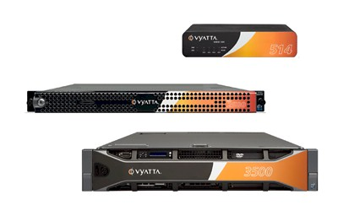
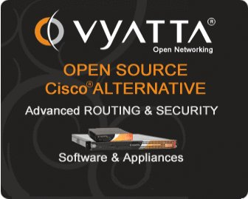

Slide 10
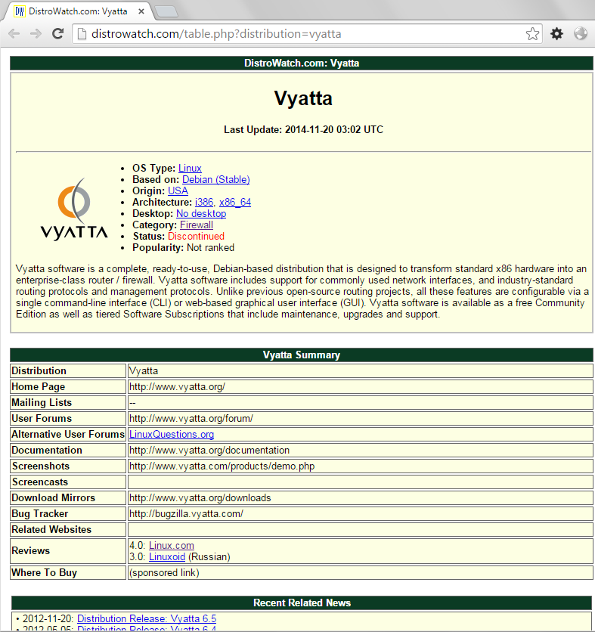

Slide 11
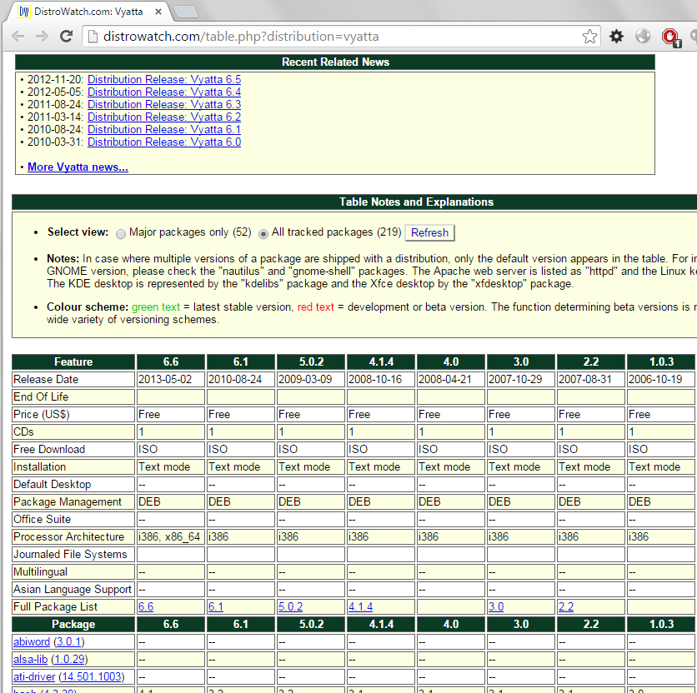

Slide 12
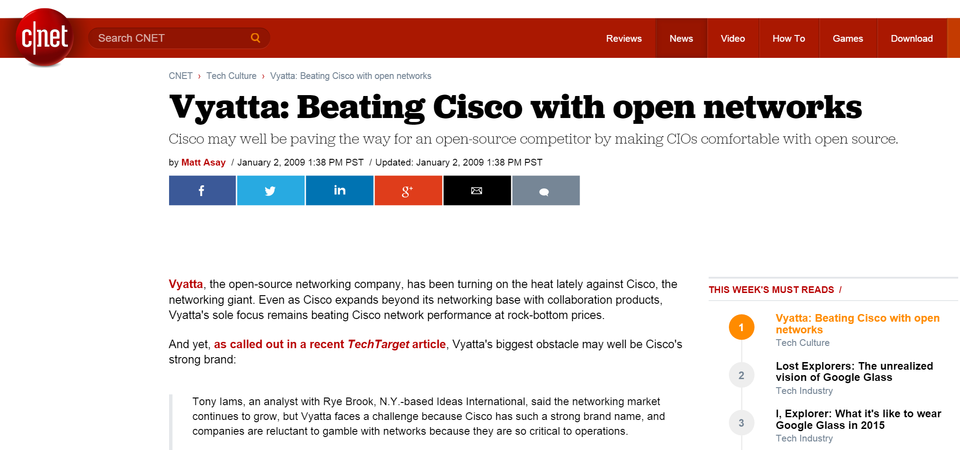
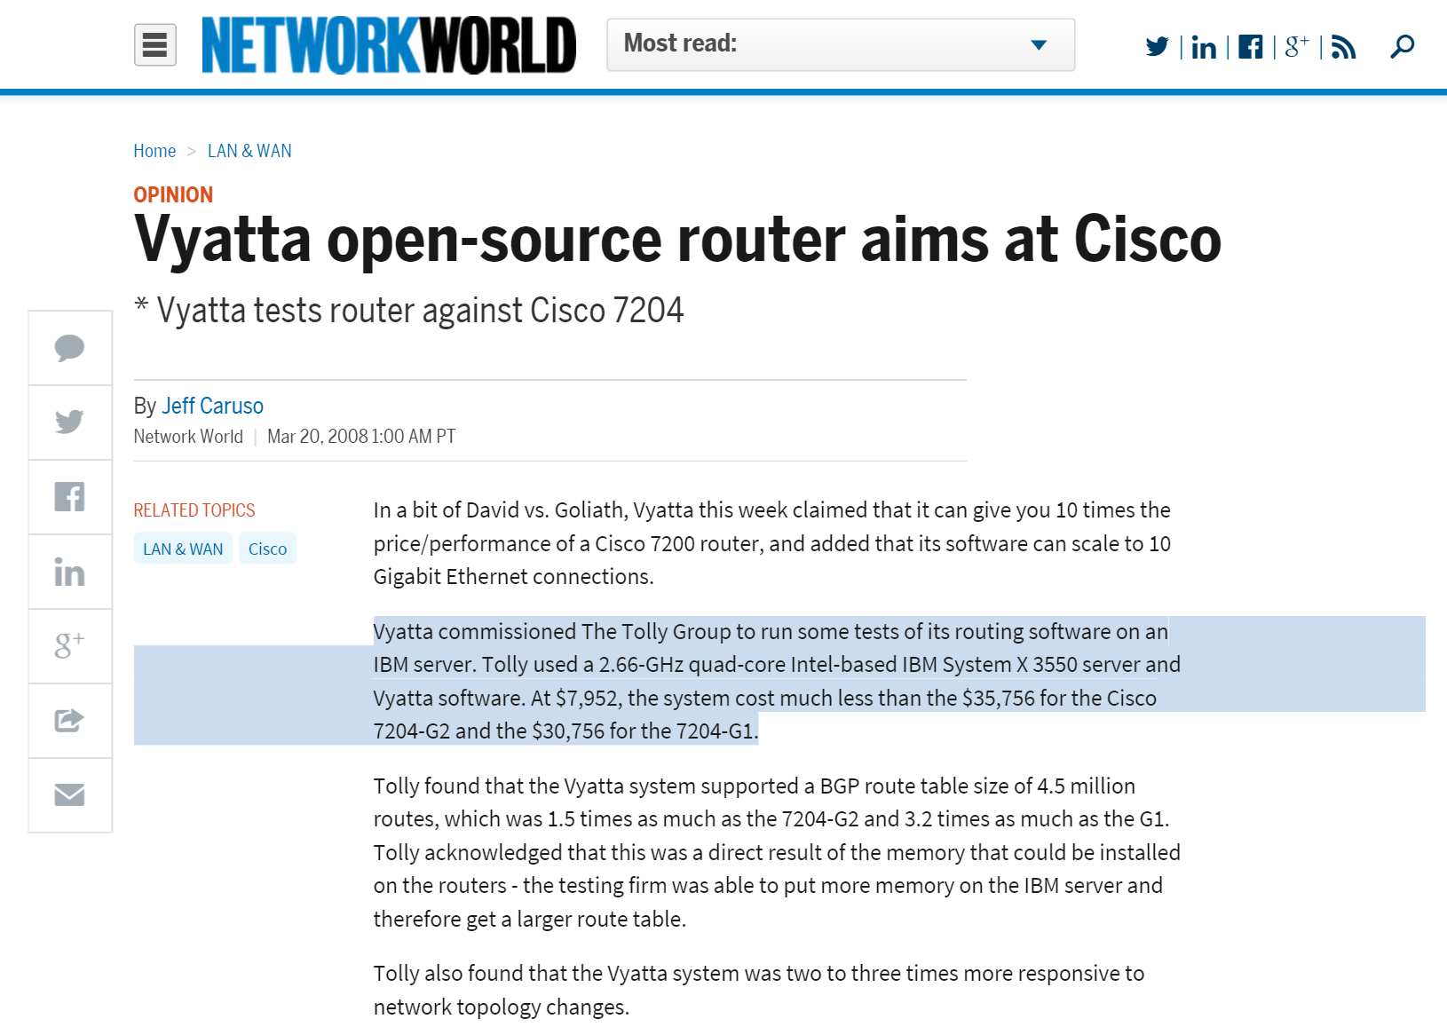

Slide 13

Vyatta Advantage
Most widely deployed vRouter in the world
10x Cisco’s throughput
Supports all major hypervisors
Linux Based
Restful APIs
Benchmark (2/25/13)
Cisco CSR 1000v Vyatta
HW: Cores 4 cores 1 core
HW: Type New Any
Throughput 50 Mbps 500 Mbps

Slide 14


Single, Integrated Product
Router
Firewall
VPN
vRouter
Next Generation
Cloud (Multi Tenancy, Hybrid, Virtual)
SDN (Software Defined Network)
NFV (Network Function Virtualization)
OSPF, BGP
Stateful, NAT
IPSec, SSL

Slide 15
Router Highlights
Routing
IPv4, IPv6, Static, PBR, OSPF, RIP, BGP
Security
IPv4, IPv6, Stateful Firewall, NAT, Zone Based Firewall
VPN
IPSec, SSL, Route-based, L2-bridging
System Management
CLI, REST API, GUI
IP Services
SSH, DHCP, DNS, SNMP
High Availability
VRRP, Stateful Failover, Config Sync
Platforms
VMware, Xen, KVM, Hyper-V, x86
Notes:
Read through each block: To highlight Vyatta’s breadth, this slide reflects our standards based approach to provide routing (protocols such as BGP, OSPF, RIP…), from a security perspective, we provide stateful firewall, VPN (IPSEC and OPENVPN); threat protection (traffic and web filtering), system management, IP Services in high availability across standard platforms…
(SALES FOLKS: this slide is features and benefits, it is a high level representation of our system, just highlight the ones you know or that make your presentation flow, do not read this slide!)….

Slide 16

2013: Brocade Acquired/Killed Vyatta in

Slide 17
Dead? - Not Totally
2013 - VyOS born
A community fork of the GPL portions of Vyatta Core 6.6R1
Open Source – Committed to Debian Social Commitment
Minimal Features – To make it manageable
Japanese User Group, Universities/Coporates
Debian 6.0 Squeeze

Slide 18
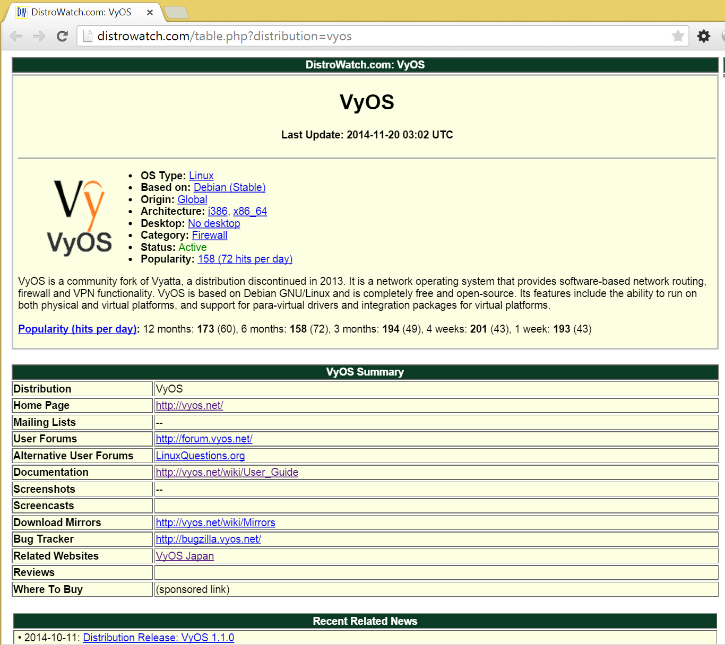

Slide 19
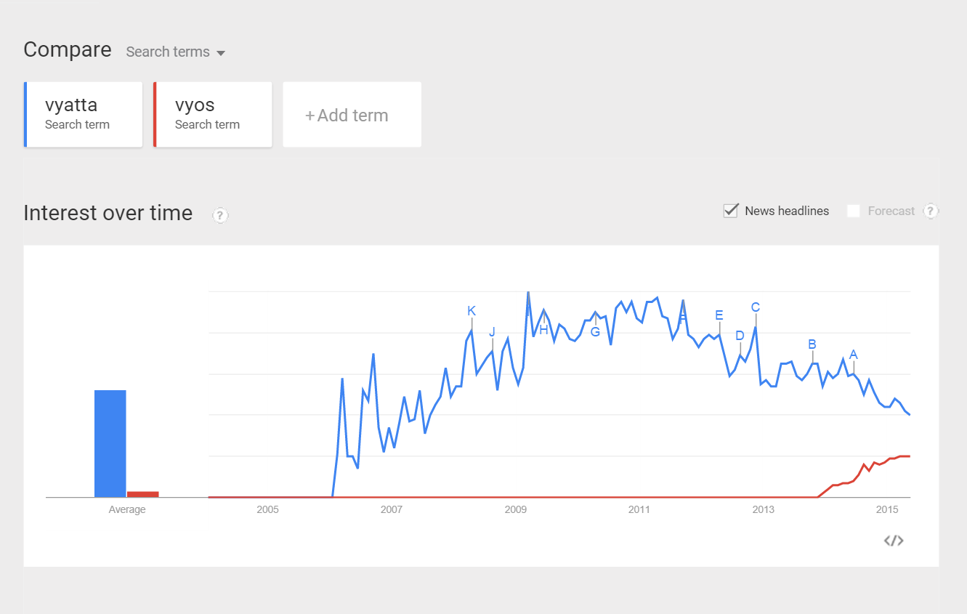

Slide 20
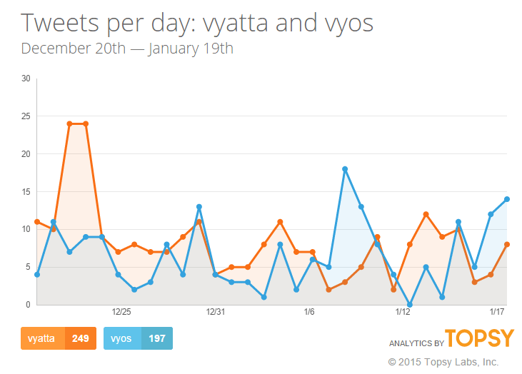

Slide 21
Architecture
CLI
API
GUI
Data Model
Routing
Firewall
NAT
VPN
QoS
IPv6
Linux Kernel with Multi-Platform Virtualization Drivers

Slide 22
VyOS
Not a SOHO (like D-Link, Linksys, …): you should know what you do
A world class router/VPN/firewall
Personal, Business Use – e.g. Site to Site IPSEC, Cloud to Cloud Bridge
Replacement: EdgeOS, pfSense, Cisco ASA/Routers, Cisco v1000
Research: use it as a serious Router/Firewall add your function & benchmark
Contribution Ideas
WebUI / Core Features / Network Courses / e.g. TCPCrypt Socket Encryption

Slide 23
Resources and References
Project Goals http://vyos.net/wiki/Project_Goals
Blog http://blog.vyos.net/
WebSite http://vyos.net/
GitHub http://github.com/vyos/
WiKi http://vyos.net/wiki
FAQ http://vyos.net/wiki/FAQ
vBuddy http://www.vyatta4people.org/ , http://blog.cyberlynx.eu/

Slide 24
Hardware Resource
 | Disk | RAM
Minimum | 2GB | 128MB
Recommended | 3GB or more based on usage (if you have cache or need image upgrade) | 512MB or more Based on usage (high concurrency on nat, cache, vpn, …)

Slide 25
Releases
Hydrogen is 1.0 – First Major Release (Late 2013)
http://vyos.net/wiki/Hydrogen
Helium 1.1.0 (Summer 2014)
http://vyos.net/wiki/Helium
Lithium 1.2.0 (Spring 2015)
http://vyos.net/wiki/Lithium

Slide 26
Workshop
Live Mode
Installation
CLI Concepts
Configuration Mode/Commit/Rollback/Save/Show Info/exit, exit discard, description
TAB & Abbreviation
Initialization
Set and Show : Hostname, IP address, Gateway, DNS, SSH, User
Basics
Configuration: Set/Edit/commit-confirm/confirm/compare/discard
/history/show & monitor log/ | commands
Configuration Scenarios
NAT / Web Cache / VPN Server / Firewall Rules
Hacks
FS Layout, Build ISO, vbash, add new commands, vbuddy, install debian packages

Slide 27
Install & CLI
Login: vyos / vyos
Install:
install image
reboot
CLI
s[tab]
show [tab]
[q] quit
[space] page down
[b] page up
configure, exit

Slide 28
CLI Concepts
show configuration
show configuration commands
configure
show interfaces
set interfaces ethernet eth0 description 'OUTSIDE‘
show interfaces
delete interfaces ethernet eth0 description 'OUTSIDE
changes
commit
discard
exit
exit discard

Slide 29
Basic Setup
IP Address
Static
set interface ethernet eth0 address 192.168.1.123/24
DHCP
set interfaces ethernet eth0 description 'OUTSIDE'
set interfaces ethernet eth0 address 'dhcp'
SSH
set service ssh port ‘22’
set service ssh listen-address 192.168.1.123

Slide 30
Basic Setup
Gateway
set system gateway-address '192.168.22.254'
Hostname
set system host-name 'vyos‘
DNS (required for web proxy)
set system name-server '192.168.22.253'

Slide 31
Static Route
set protocols static route 192.168.113.0/24 next-hop 172.20.13.1 distance ‘1‘

Slide 32
DNS Forwarder
set service dns forwarding cache-size ‘0‘
set service dns forwarding listen-on 'eth1‘
set service dns forwarding name-server '8.8.8.8'

Slide 33
NAT
Masquerade
set nat source rule 100 outbound-interface 'eth0'
set nat source rule 100 source address '192.168.1.0/24'
set nat source rule 100 translation address 'masquerade‘
DNAT
set nat destination rule 10 description 'Port Forward: HTTP to 192.168.0.100'
set nat destination rule 10 destination port '80'
set nat destination rule 10 inbound-interface 'eth0'
set nat destination rule 10 protocol 'tcp'
set nat destination rule 10 translation address '192.168.0.100'

Slide 34
Bridging
Bridging
set interfaces bridge 'br100'
set interfaces ethernet eth1 vif 100
bridge-group bridge br100
set interfaces bridge br100 address '192.168.100.1/24‘
set interfaces bridge br100 stp true
show bridge
show bridge br100 spanning-tree

Slide 35
Setup a DHCP Server
set service dhcp-server disabled ‘false‘
set service dhcp-server shared-network-name LAN subnet 192.168.0.0/24 default-router ‘192.168.0.1‘
set service dhcp-server shared-network-name LAN subnet 192.168.0.0/24 dns-server ‘192.168.0.1‘
set service dhcp-server shared-network-name LAN subnet 192.168.0.0/24 domain-name ‘internal-network
set service dhcp-server shared-network-name LAN subnet 192.168.0.0/24 lease ‘86400‘
set service dhcp-server shared-network-name LAN subnet 192.168.0.0/24 start 192.168.0.9 stop ‘192.168.0.254'

Slide 36
Setup Web Proxy
Turn on
set service webproxy listen-address 192.168.0.1
set service webproxy listen-address 192.168.0.1 port 3128
set service webproxy listen-address 192.168.0.1 disable-transparent
Cache
set service webproxy cache-size 100
URL Filter
set service webproxy url-filtering squidguard local-block google.com
set service webproxy url-filtering squidguard log local-block

Slide 37
Resources and References
Project Goals http://vyos.net/wiki/Project_Goals
Blog http://blog.vyos.net/
WebSite http://vyos.net/
GitHub http://github.com/vyos/
WiKi http://vyos.net/wiki
FAQ http://vyos.net/wiki/FAQ
vBuddy http://www.vyatta4people.org/ , http://blog.cyberlynx.eu/

Slide 38
Advanced Scenarios using Vyos/vyatta
Even DMVPN

Slide 39


Cloud Bridging
Database
Key
Application
IPSEC VPN (L3)
Web
OpenVPN (L2)
Vyatta AMI
(NAT + VPN)
Public IP:
76.74.103.12
Datacenter
Public
VPC Internet Gateway
INTERNET
10.0.0.26
EIP: 184.72.121.67
vpc-928dbffb
10.0.0.0/16
Private
10.0.1.0/16
VPC Internet Gateway
Full mesh VPN between multiple VPCs and datacenter
Layer 2or Layer 3
Use for cloud bursting, HA, phased application moves . . .
Private
192.168.1.0/16
Vyatta AMI
(NAT + VPN)
vpc-947f42fd
192.168.0.0/16
Public
192.168.0.92
EIP: 184.72.110.240

Slide 40
Virtual Networking
Database
Traffic inspected at virtual layer
Reduced latency
Firewall services in all directions
Per-tenant dedicated network controls
On demand provisioning
Network services scale with compute infrastructure
Application
Web
INTER VLAN ROUTING, FIREWALL,VPN, AND TRAFFIC INSPECTION
ACCESS
AGGREGATION
VIRTUAL
CORE
PHYSICAL
INGRESS/EGRESS
BORDER ROUTER
INTERNET
© 2013 Brocade Communications Systems, Inc. Company Proprietary Information
40
Notes:
Vyatta provides a new paradigm for true network virtualization, providing robust routing, VPN and firewall functionality within and between hypervisors. The Vyatta approach provides
Increased throughput
Reduced latencies
High Availability (through the hypervisor)
Increased fault tolerance (through the hypervisor
In hypervisor security controls
Application Isolation
Simplified network topology
Most of all, the Vyatta solution adds agility – allowing system architects to add networking functions that can be deployed with the speed of software.

Slide 41



Multi-Tenant Cloud Datacenter
Use virtual routers to deploy on-demand
Per-tenant network segmentation and security
Highlights
Firewall
NAT
OSPF
Stateful failover
Configuration sync
IPSec or OpenVPN
VLAN
VLAN
3
3
2
2
1
1
VM
VM
Master
Backup
VLAN
VLAN
VLAN
VLAN
ESX
ESX
Physical Network Fabric
Physical Network Fabric
Virtual Routed Security Gateway

Slide 42




VyOS in the Public Cloud
Scalable VPN services
Office to VPC
User to VPC
VPC to VPC connectivity
Advanced routing
Full mesh topologies
High availability architectures
Traffic management
IPSEC and SSL
Available in Amazon Marketplace
Amazon Virtual Private Cloud (VPC)
Amazon Virtual Private Cloud (VPC)
Rackspace Private Cloud (VPC)
VM
VM
Customer Data Center

Slide 43


Software Defined Datacenter
Prod-App
BACKUP NETWORKS
QA-App
Backup
Management
MGMT
NETWORKS
APP TIER
Dev-App
CORE NETWORK
DB TIER
WEB TIER
CORE NETWORK
FWD DMZ
RA-FWD-IF
VDI
RA VPN
You are already deploying virtual servers
INTERNET
RA-RWD-IF
REMOTE ACCESS VPN AND VDI TIER FOR ADMINISTRATION
RA-FWD-IF

Slide 44
Virtualize the Network
Prod-App
BACKUP NETWORKS
QA-App
Backup
Management
MGMT
NETWORKS
APP TIER
Dev-App
CORE NETWORK
DB TIER
WEB TIER
CORE NETWORK
FWD DMZ
RA-FWD-IF
RA VPN
Now virtualize the network
INTERNET
RA-RWD-IF
REMOTE ACCESS VPN AND VDI TIER FOR ADMINISTRATION
RA-FWD-IF

Slide 45

Datacenter-In-A-Box
VIRTUAL
PHYSICAL
HIGH SPEED BACKPLANE (TB/s)
Template and roll out new datacenters on-demand
INGRESS
EGRESS
HIGH SPEED INTERCONNECT TO STORAGE NETWORK
INTERNET
SERVICE PROVIDER
EQUIPMENT
Notes:
Here is the same network laid out in a 30,000 sq. ft. data center – or the same
Datacenter - virtualized
Solution was architected with blade chassis to provide optimal
Performance
Latency
Redundancy
Blade chassis configured with 4 10G switches for connectivity to backup system and SAN, 2 stacked 1G switches for internet connectivity, 3 half-height blades
Majority of blade traffic travels across chassis backplane.
On average running ~250 VM’s across 3 half-height blades (dual processor dual core 32MB of memory each) for 8 customers and the internal business.
Applications ranges from financial packages, inventory management systems, BI and BPM systems. Largest footprint of VMs were Oracle databases.
At peak average utilization did not exceed 60% across 3 node cluster.
Average ping response 1ms or less.

